Slide 1
Development of a Spatial and Temporal based COVID-19 Predictor for Pakistan
Supervisor : Dr. Murk Marvi
Co-Supervisor : Ms. Anam Qureshi
18K-0137 Ovaiz Ali
18K-0166 Zaeem Ahmed
18K-0166 Rabil Maknojia

Slide 2
Literature Review (Ext.)
1) COVID-19 instances and temperature had a positive association, according to the correlation analysis. It means that a spike in COVID-19 cases was observed in Pakistan, its provinces, and administrative units, as a result of rising temperatures. Second, in Pakistan, there was no link between rainfall and COVID-19 instances. [15]
2) Finally, there was a negative association between humidity and total COVID-19 instances, implying that increasing humidity is advantageous in preventing COVID-19 transmission across Pakistan, its provinces, and administrative units. In Sindh province, humidity and COVID-19 instances were found to be positively associated. [15]
3) COVID-19 instances are influenced by a variety of factors, including geographical landscapes, economic situations, demographic illness variations, genetic factors, health care system, number of tests, and age disparities, among others. [5]
4) A huge number of undetected infected persons is also a crucial factor contributing to the spread of COVID-19. [9]

Slide 3
Literature Review (Ext.)
5) Single exponential smoothing, Holt linear trend technique, Holt winter method, and the auto-regressive integrated moving average (ARIMA) model, which was originally created for economics applications, are among the forecasting methods utilized. [6]
6) Two statistical indices, RMSE (Root Mean Square Error) and MAE (Mean Absolute Error), are used in the above mentioned models to determine the best candidate model for predicting [6]
7) Using previous data, an artificial neural network with a rectifying linear unit-based technique is used to estimate the number of deaths, recovered, and confirmed cases of COVID-19 in Pakistan. The acquired data was separated into training and test data, which were used to evaluate the suggested technique's effectiveness [8,9]
8) We turn places into nodes on a network and generate edges based on geographical proximity and demographic similarity in the Spatio-Temporal Attention Network (STAN) for pandemic prediction based on real-world evidence. Each node is linked to a set of static and dynamic features derived from a range of real-world evidence in medical claims data, such as illness prevalence and medical resource consumption conditions [10]

Slide 4


FYP-I Deliverables
Data Collection | Data Visualization

Slide 5
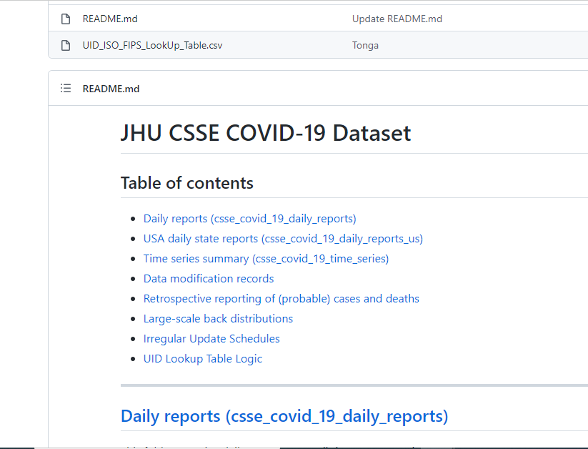


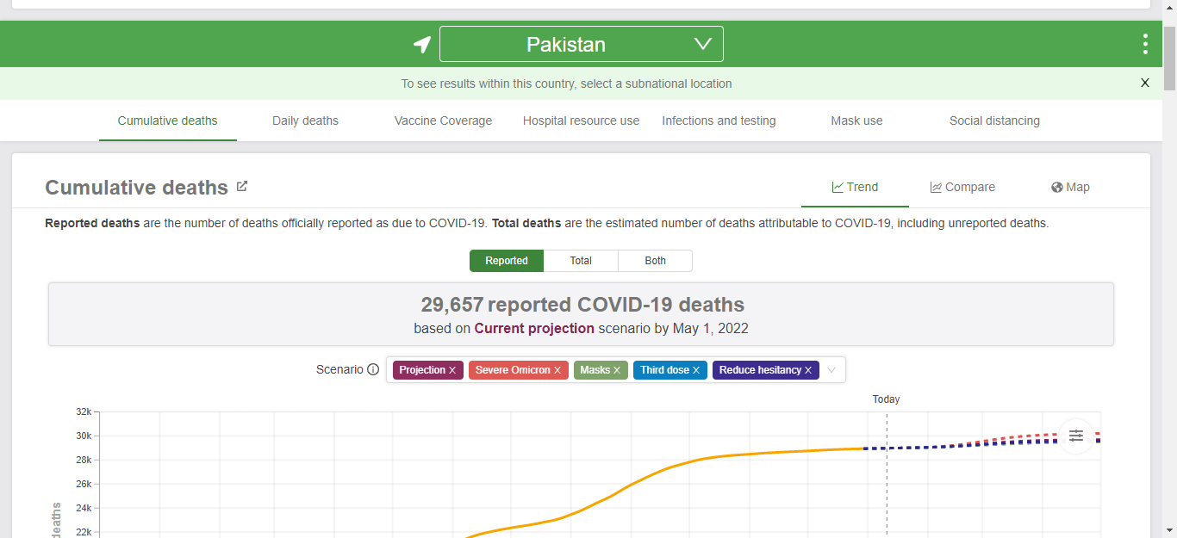
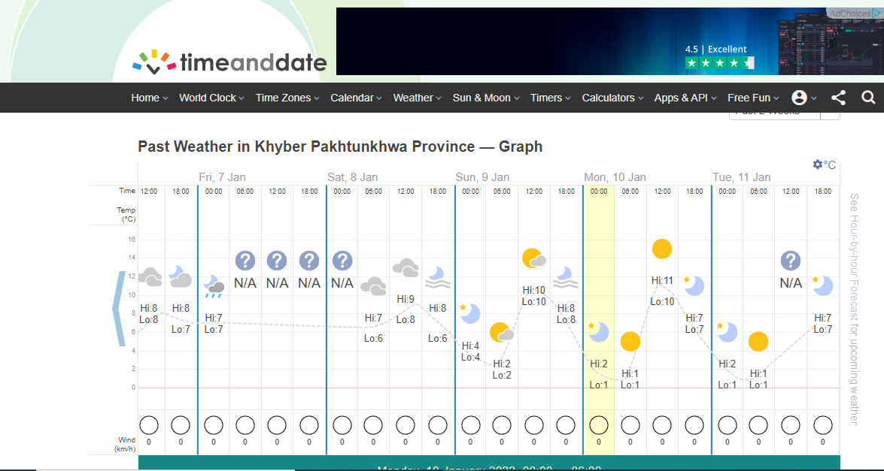
Data Collection [03/10/2020 to 10/18/2021]

Slide 6
Data Visualization
Country-
Based
Province-
Based

Slide 7
Country-Based Visualizations

Slide 8
Province-Based Visualizations

Slide 9
References
1. Bag, Rakhohori, et al. "Understanding the spatio‐temporal pattern of COVID‐19 outbreak in India using GIS and India's response in managing the pandemic." Regional Science Policy & Practice 12.6 (2020): 1063-1103.
2. Hazbavi, Zeinab, et al. "Spatial and temporal analysis of the COVID-19 incidence pattern in Iran." Environmental Science and Pollution Research 28.11 (2021): 13605-13615.
3. Huang, Rui, Miao Liu, and Yongmei Ding. "Spatial-temporal distribution of COVID-19 in China and its prediction: A data-driven modeling analysis." The Journal of Infection in Developing Countries 14.03 (2020): 246-253.
4. Sartorius, B., A. B. Lawson, and R. L. Pullan. "Modelling and predicting the spatio-temporal spread of COVID-19, associated deaths and impact of key risk factors in England." Scientific reports 11.1 (2021): 1-11.
5. Mehmood, Khalid, et al. "Spatiotemporal variability of COVID-19 pandemic in relation to air pollution, climate and socioeconomic factors in Pakistan." Chemosphere 271 (2021): 129584.
6. Ali, Muhammad, et al. "Forecasting COVID-19 in Pakistan." Plos one 15.11 (2020): e0242762.

Slide 10
References
7. Waqas, Muhammad, et al. "Analysis and prediction of COVID-19 pandemic in Pakistan using time-dependent SIR model." arXiv preprint arXiv:2005.02353 (2020).
8. Ahmad, Iftikhar, and Syed Muhammad Asad. "Predictions of coronavirus COVID-19 distinct cases in Pakistan through an artificial neural network." Epidemiology & Infection 148 (2020).
9. Shwartz-Ziv, Ravid, Itamar Ben Ari, and Amitai Armon. "Spatial-Temporal Convolutional Network for Spread Prediction of COVID-19." arXiv preprint arXiv:2101.05304 (2020).
10. Gao, Junyi, et al. "STAN: spatio-temporal attention network for pandemic prediction using real-world evidence." Journal of the American Medical Informatics Association 28.4 (2021): 733-743.
11. Nikparvar, Behnam, et al. "Spatio-temporal prediction of the COVID-19 pandemic in US counties: modeling with a deep LSTM neural network." Scientific reports 11.1 (2021): 1-12.
12. Vahedi, Behzad, Morteza Karimzadeh, and Hamidreza Zoraghein. "Spatiotemporal prediction of COVID-19 cases using inter-and intra-county proxies of human interactions." Nature communications 12.1 (2021): 1-15.

Slide 11
References
13. Sarwar, Suleman, et al. "COVID-19 challenges to Pakistan: Is GIS analysis useful to draw solutions?." Science of the Total Environment 730 (2020): 139089.
14. Saeed, Urooj, et al. "Identification of potential lockdown areas during COVID-19 transmission in Punjab, Pakistan." Public health 190 (2021): 42-51.
15. Raza, Ali, et al. "Association between meteorological indicators and COVID-19 pandemic in Pakistan." Environmental Science and Pollution Research 28.30 (2021): 40378-40393.
16. Khakharia, Aman, et al. "Outbreak prediction of COVID-19 for dense and populated countries using machine learning." Annals of Data Science 8.1 (2021): 1-19

